Slide 1
Chapter 8: Basic Principles and Knobology

Slide 2
Chapter Objectives
Provide a brief overview of directional terminology and patient positioning.
Explain the function of ultrasound modes.
Offer a rationalization for the use of common universal controls found on most ultrasound machines.

Slide 3
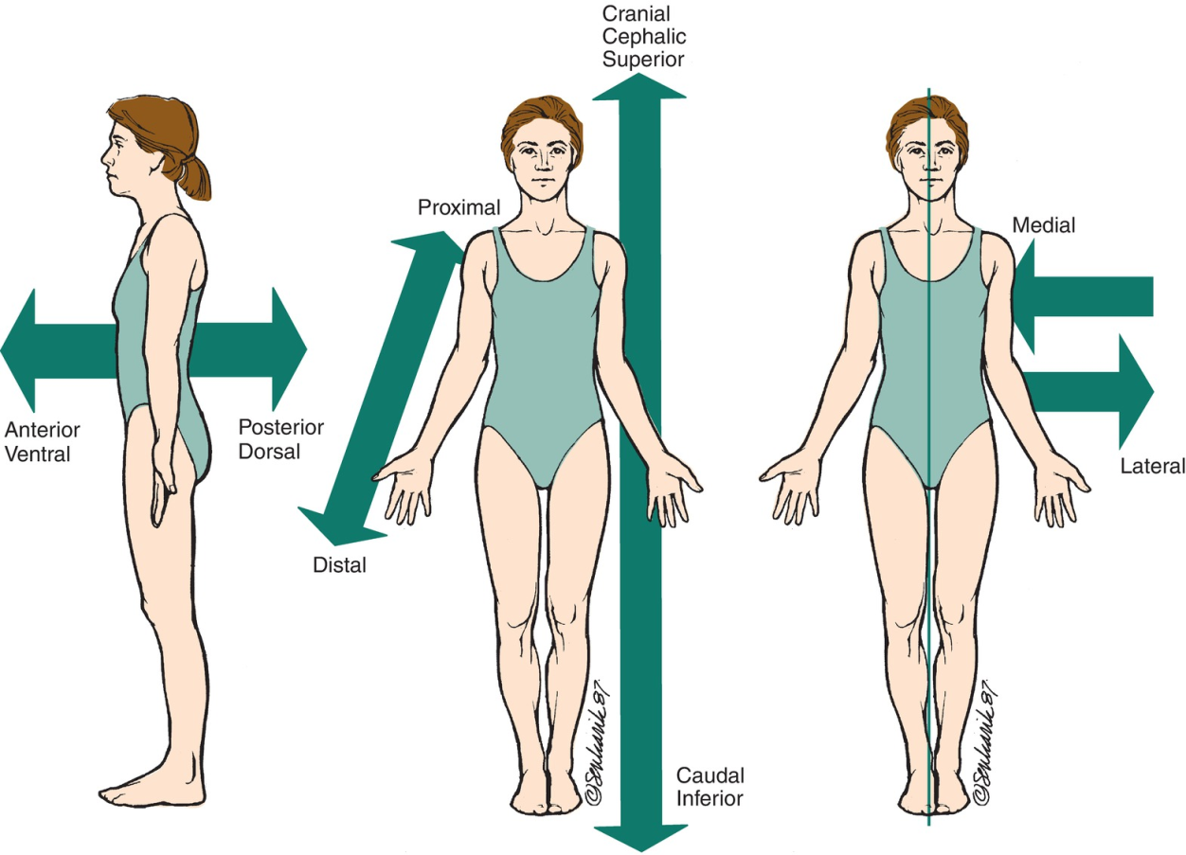
Directional Terminology and Patient Positioning
When a sonographer refers to directional terms or anatomy, it is assumed the person is in anatomic position.

Slide 4
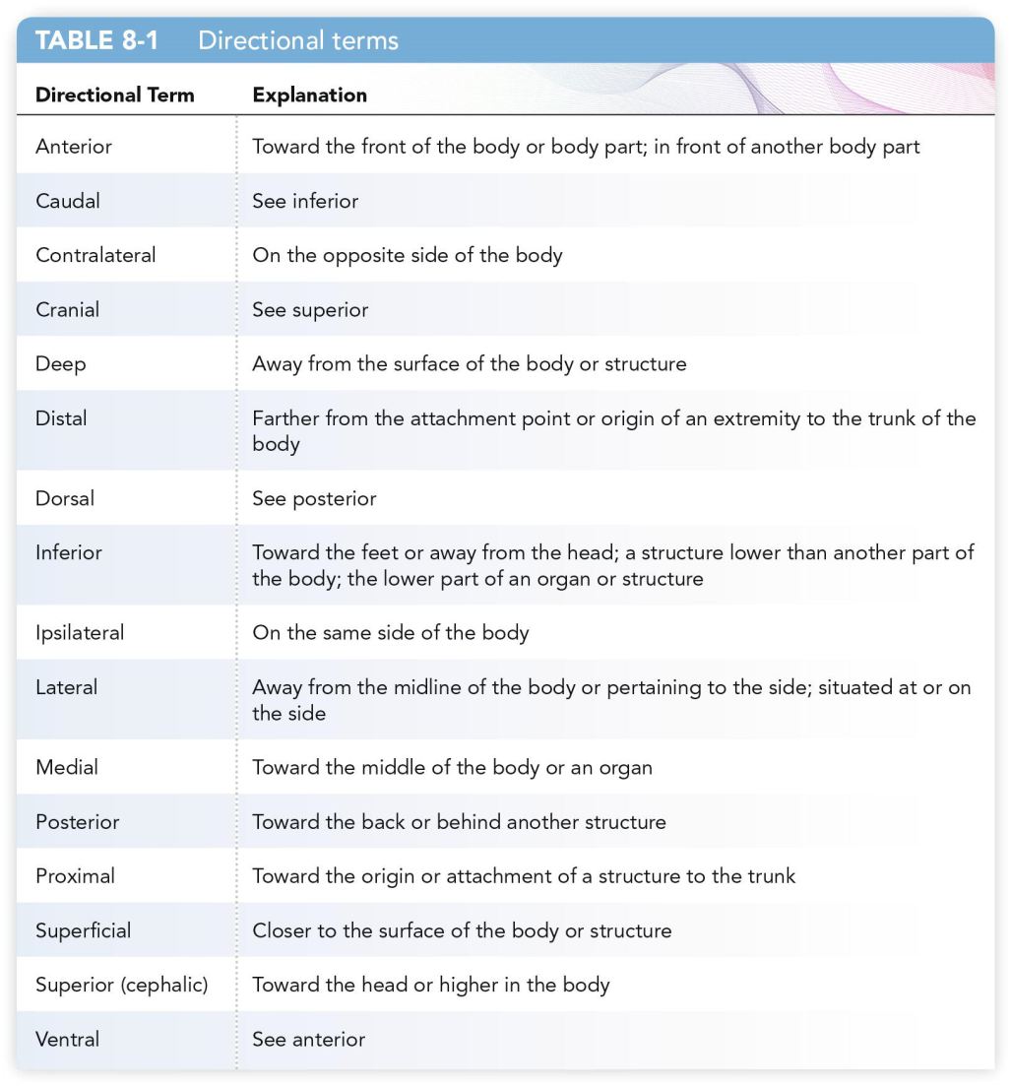
Directional Terminology and Patient Positioning (cont.)

Slide 5
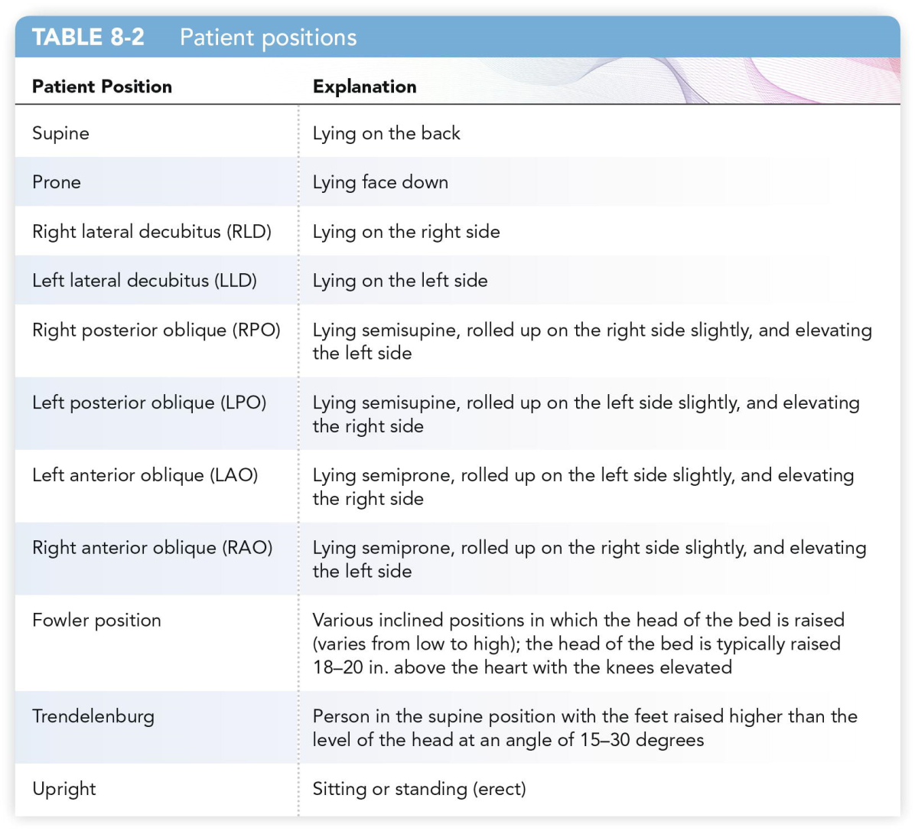
Directional Terminology and Patient Positioning (cont.)

Slide 6
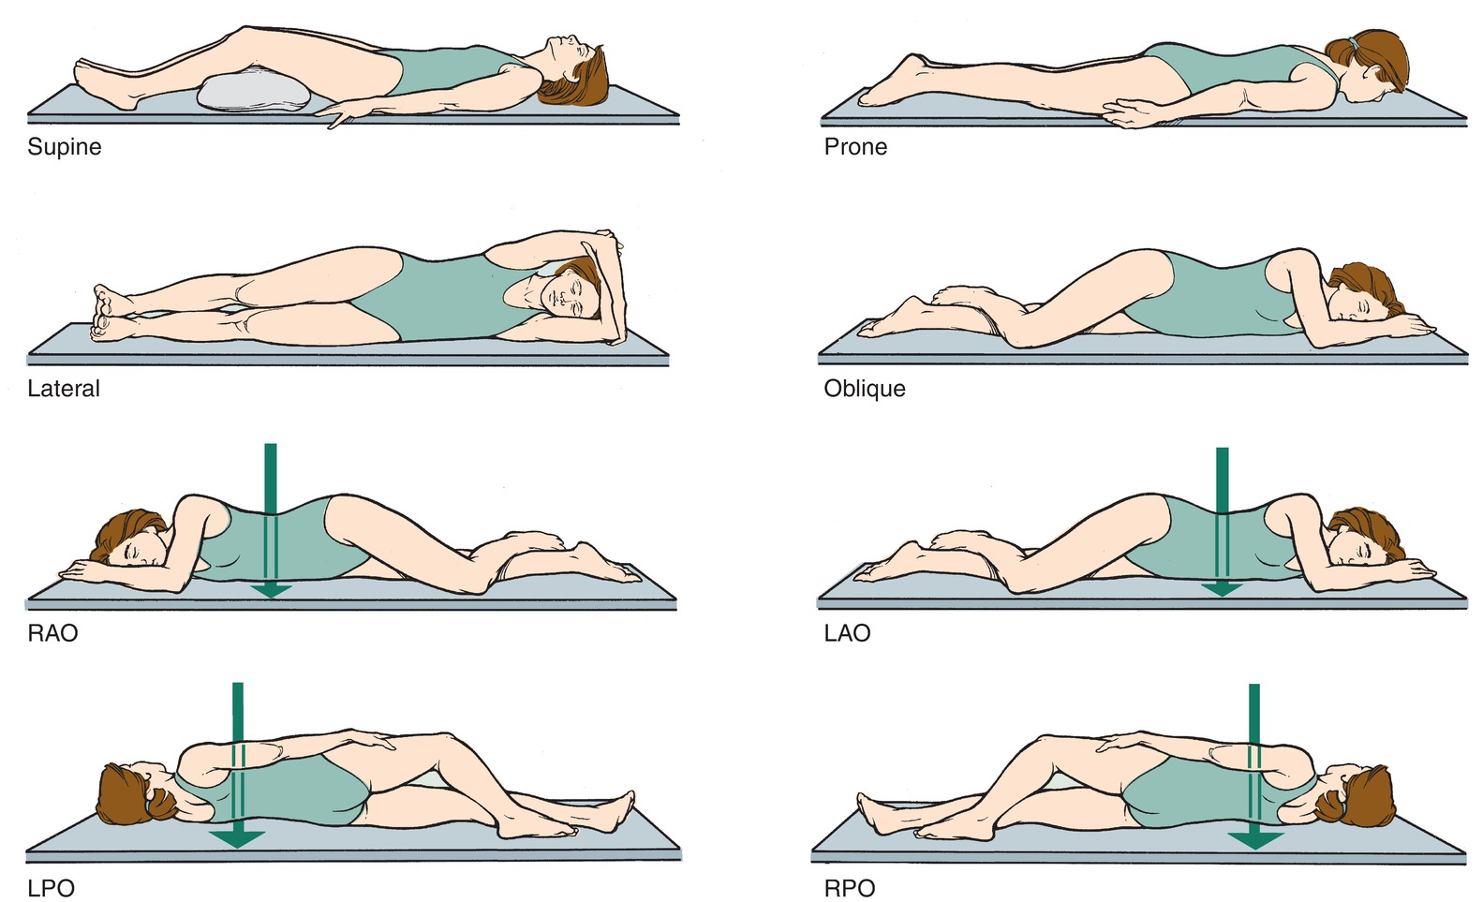
Directional Terminology and Patient Positioning (cont.)

Slide 7
Transducers
A transducer is used to obtain an image of the human body using ultrasound.
It is also referred to as a probe.
The transducer can covert energy from one form to another.
It operates using the pulse-echo principle.
The crystal inside of the transducer produces the ultrasound wave once pulsed with electricity.
The wave is sent into the body and returns to the transducer.
The strength of the echo is displayed on the system’s monitor.
Transducers come in many shapes and sizes.
These are created for explicit reasons and specific examinations.

Slide 8
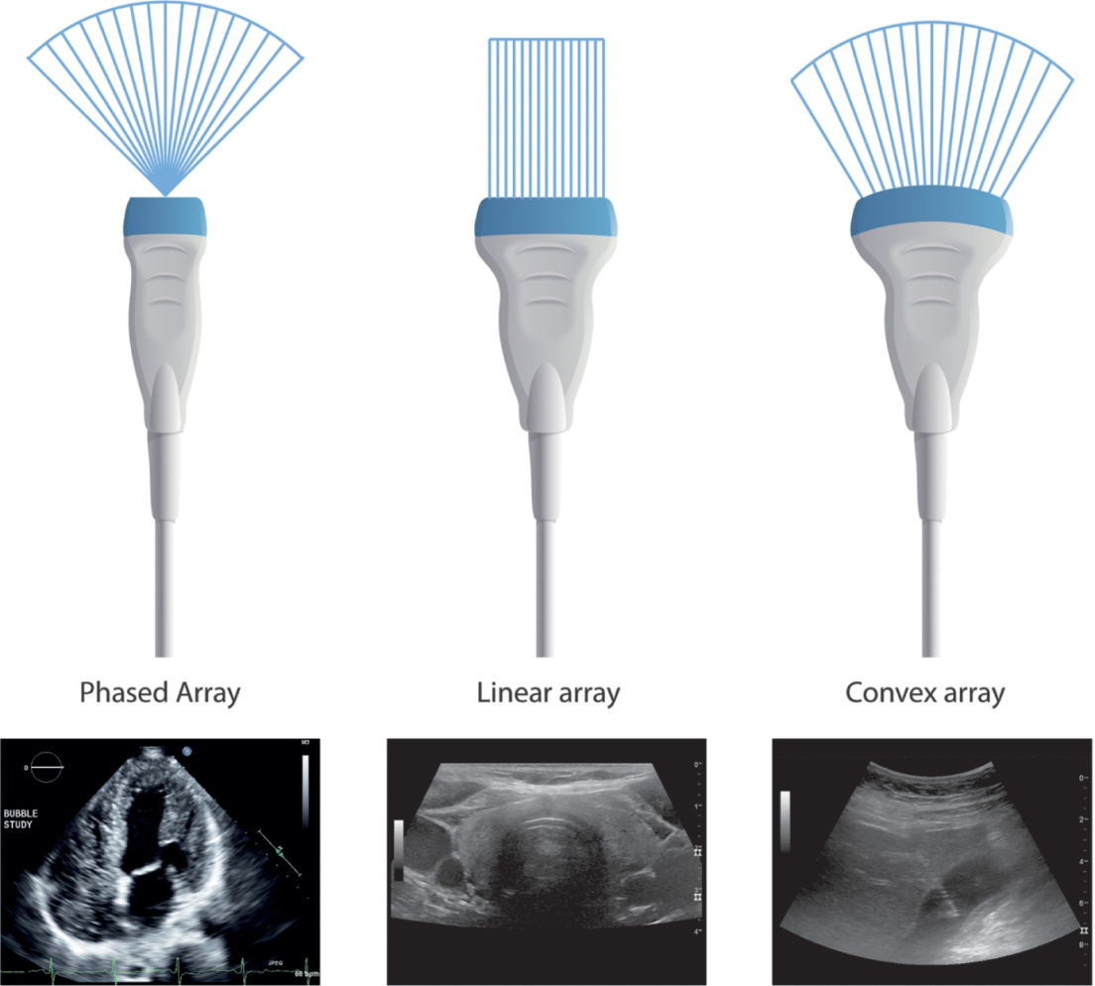
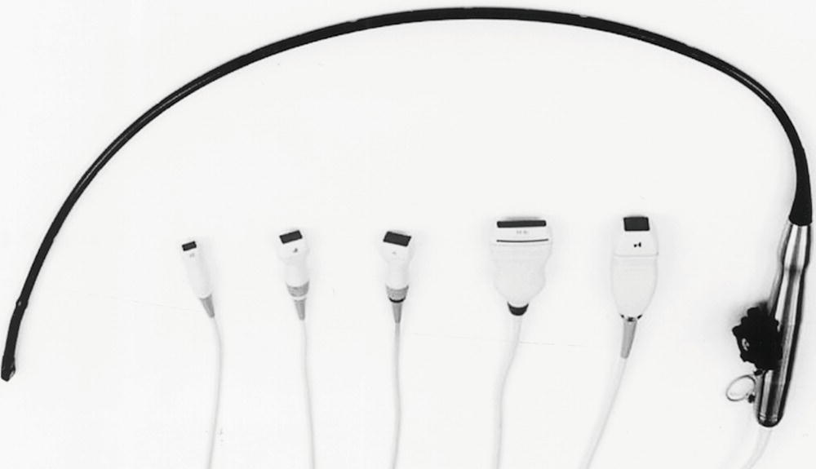
Transducers (cont.)

Slide 9
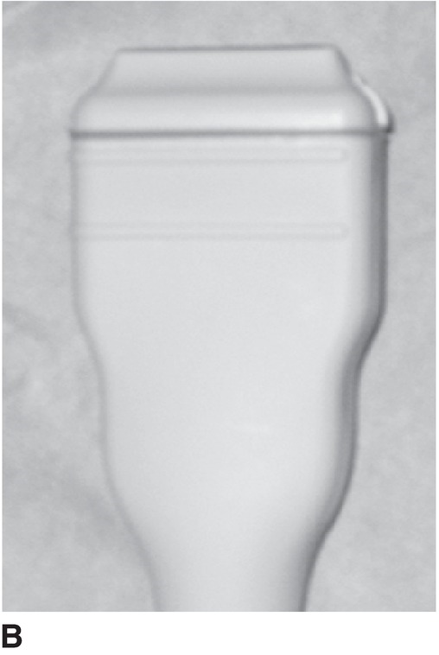
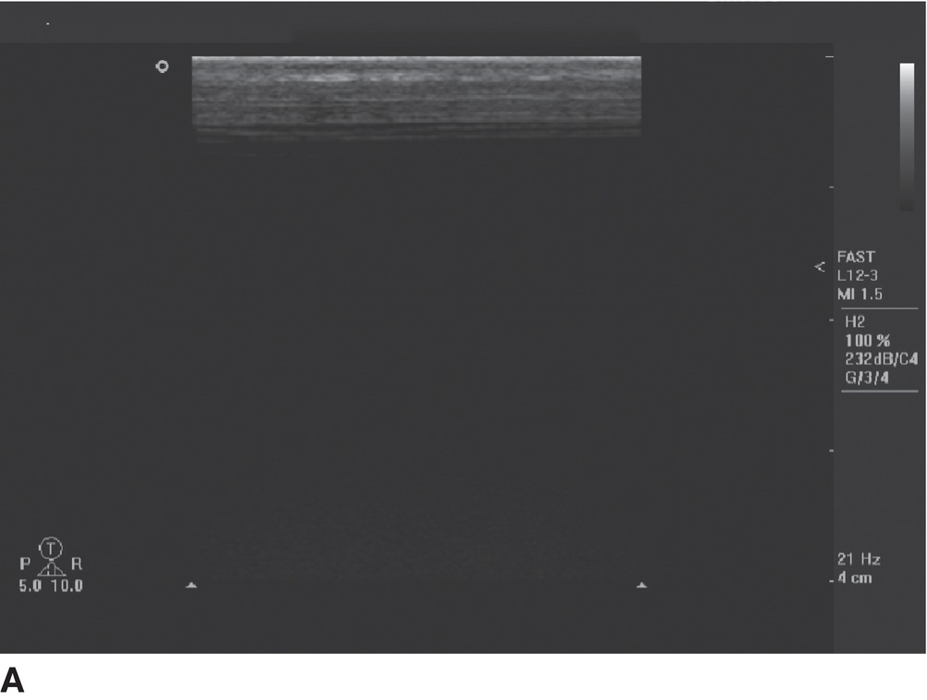
Linear Sequenced Array Transducer

Slide 10
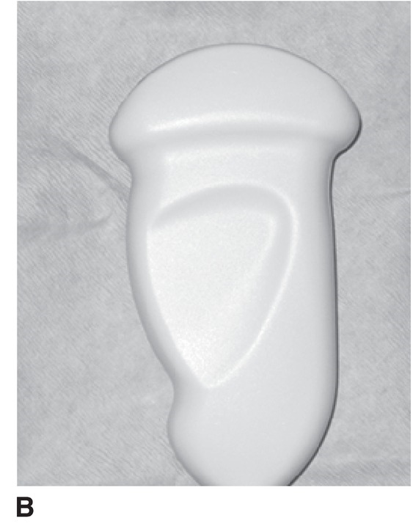
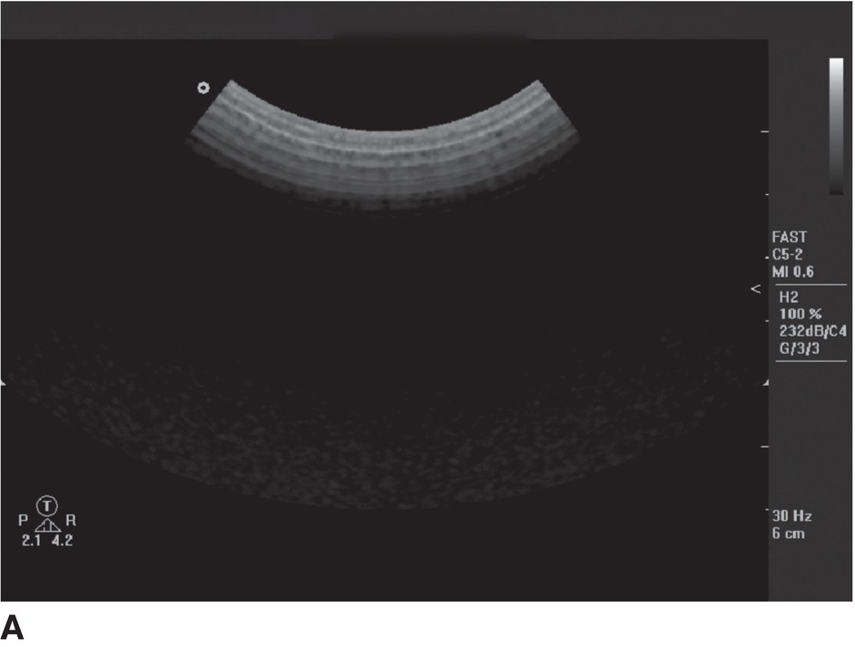
Curvilinear Array Transducer

Slide 11
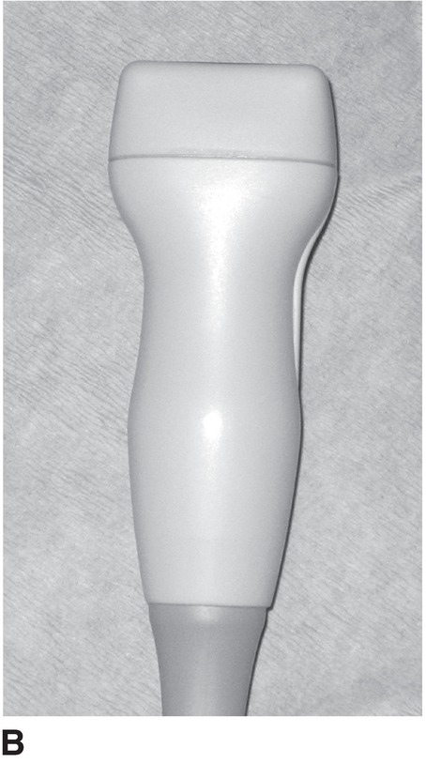
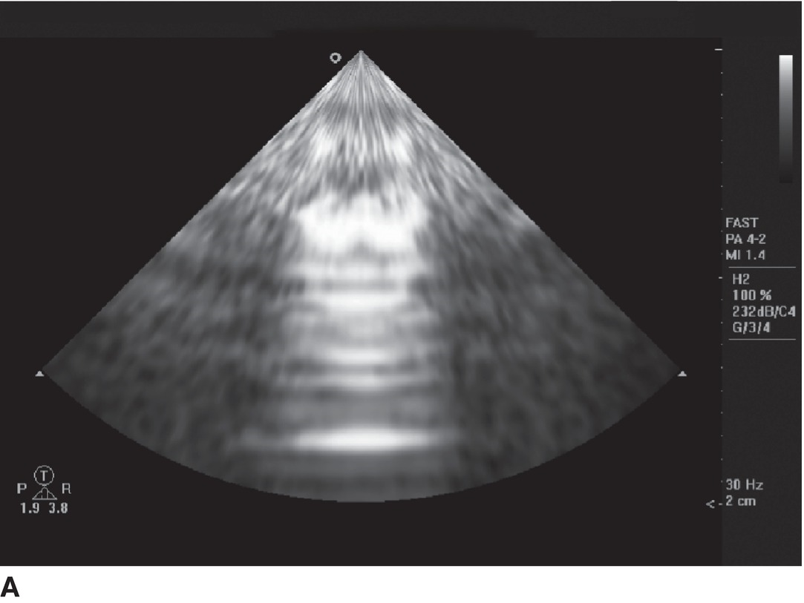
Linear Phased Array Transducer

Slide 12
Transducer Manipulation
Manipulation on the patient’s body requires the use of acoustic gel.
The gel acts as means whereby the ultrasound waves can pass through the body.
It also acts as a lubricant for ease of transducer manipulation.
For large organs like the liver, drastic movement may be needed.
Most often, fine-tuned movement is needed to enhance visualization of smaller structures within the body.
The transducer may need to be manipulated to obtain an optimal acoustic or sonographic window.
The best way to learn about how to manipulate the transducer is to practice.

Slide 13
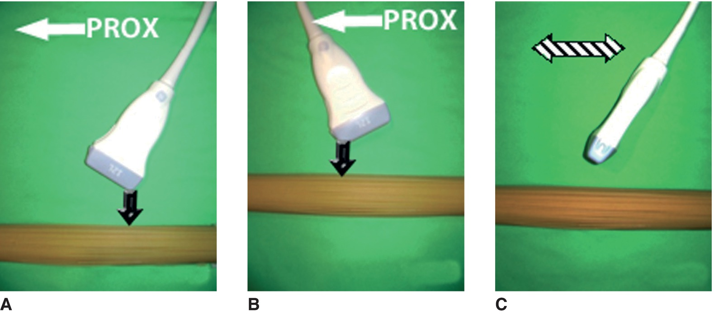
Transducer Manipulation (cont.)
Transducer manipulation. Some examples of transducer manipulation to optimize anatomic viewing include (A) “heeling” the transducer in the longitudinal plane, (B) “toeing” the transducer in the longitudinal plane, and (C) “rocking” or “toggling” the transducer in the transverse plane.

Slide 14
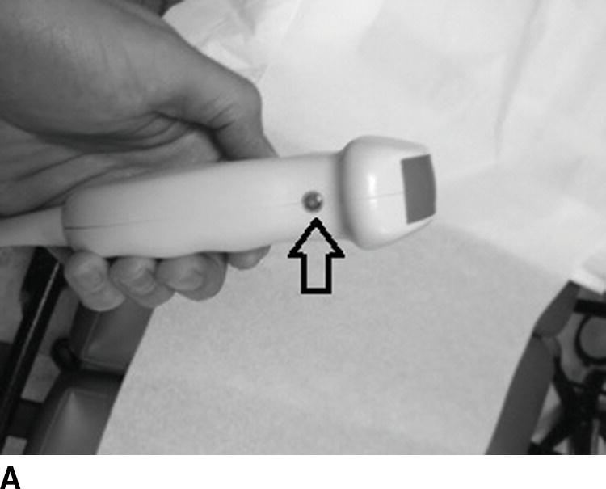
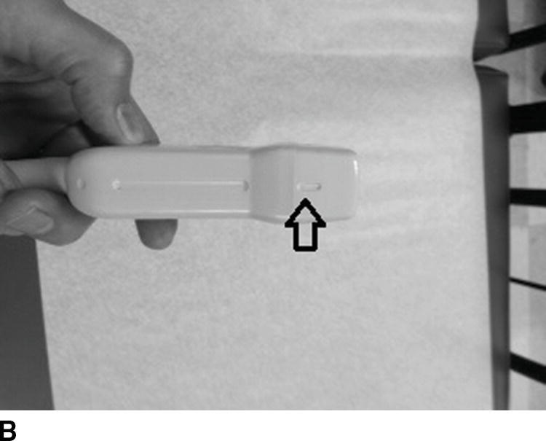
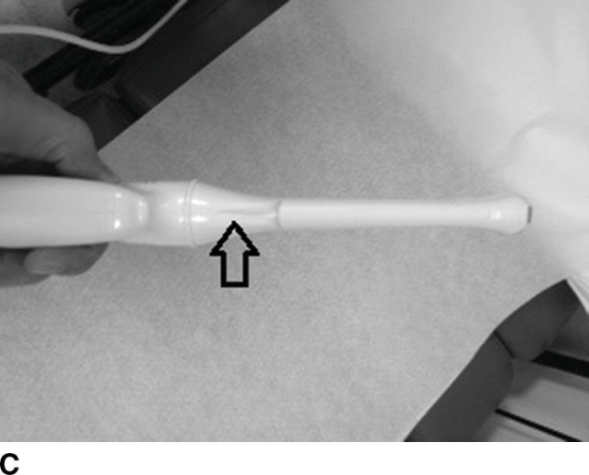
Transducer Orientation
All transducers have a reference point whereby correct transducer orientation is established by the sonographer.
This may be called the index or the notch and may be represented by a groove, light, or manufacturer symbol on one part of the transducer.
Keeping proper transducer orientation is essential to obtaining correct anatomic orientation.

Slide 15
Scanning Planes
Medical and Vascular Sonography Scanning Planes
The three most common scanning planes are:
Sagittal plane or longitudinal plane
Transverse plane
Coronal Plane
A midsagittal plane divides the body into equal left and right halves.
Transthoracic Echocardiography Scanning Planes
The sonographer adjusts the transducer to the heart in order to achieve a variety of views.
Orientation can be challenging because the acoustic windows can be exceedingly small and patient body habitus may inhibit optimal visualization of structures.

Slide 16
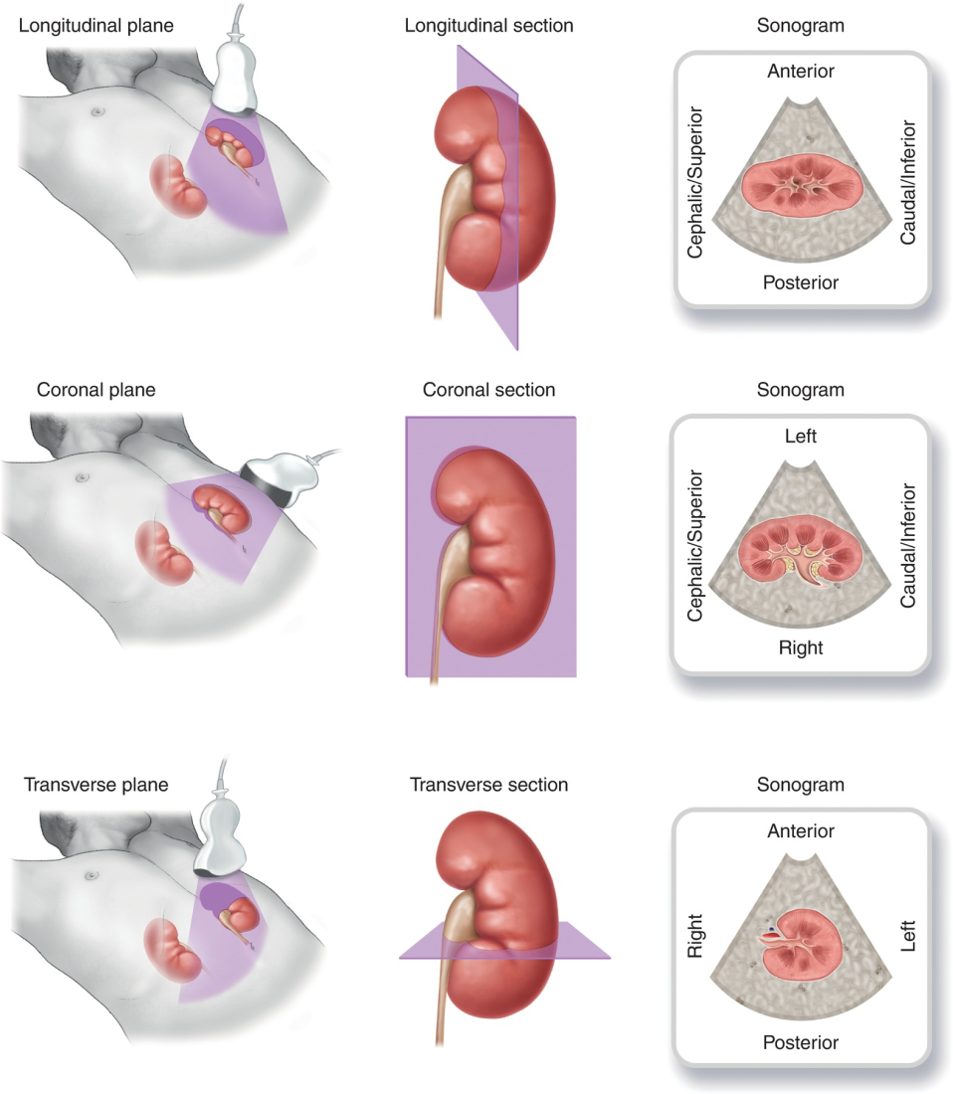
Anatomic Planes and Transducer Orientations

Slide 17
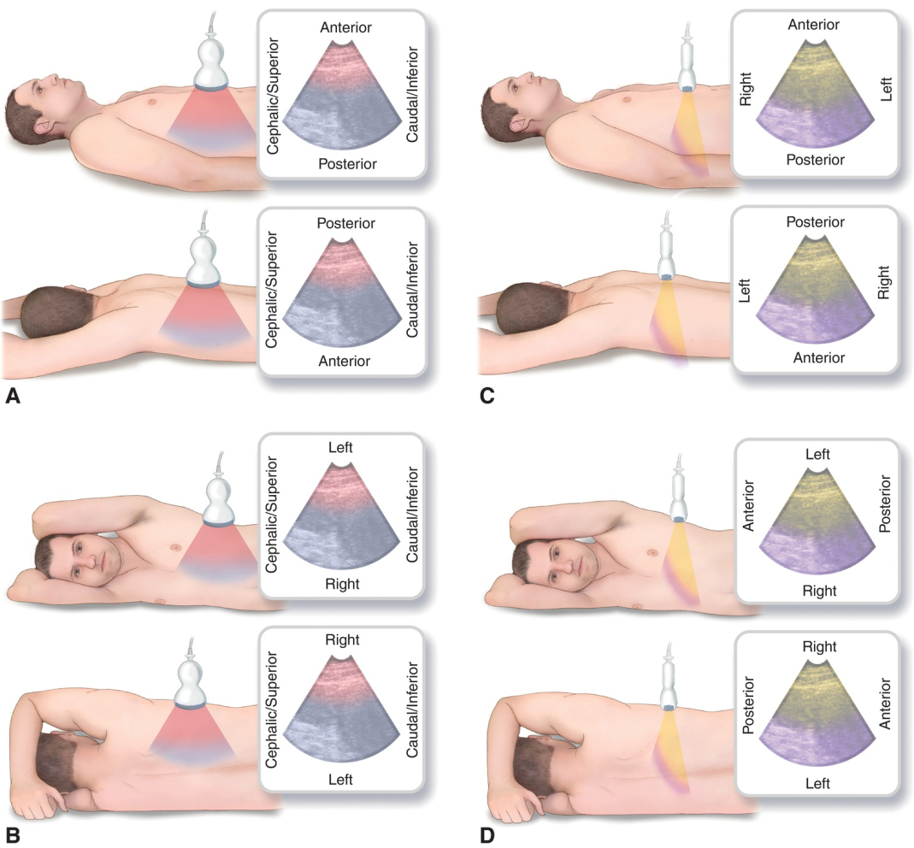
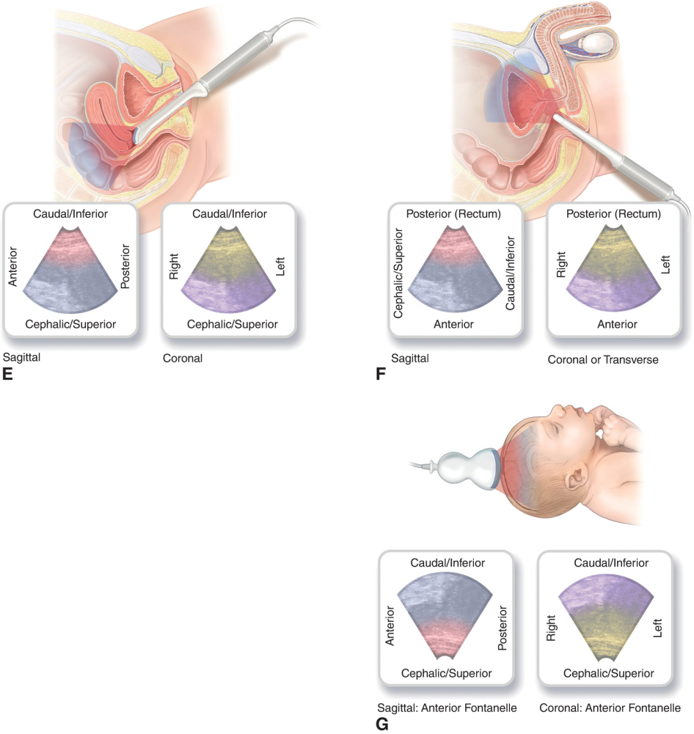
Anatomic Planes and Transducer Orientations (cont.)

Slide 18
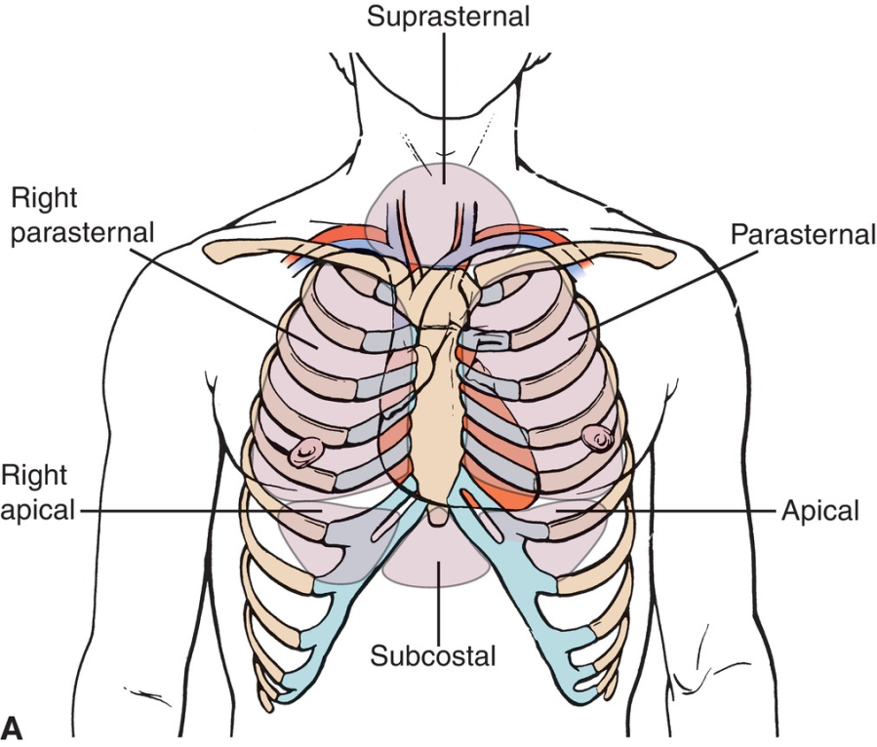
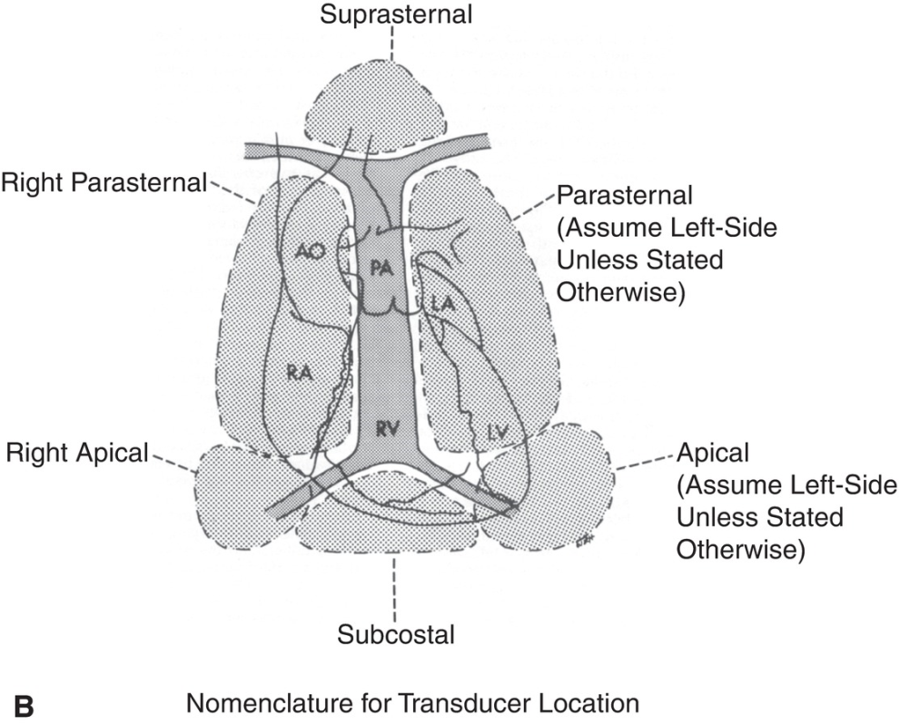
Echocardiography

Slide 19
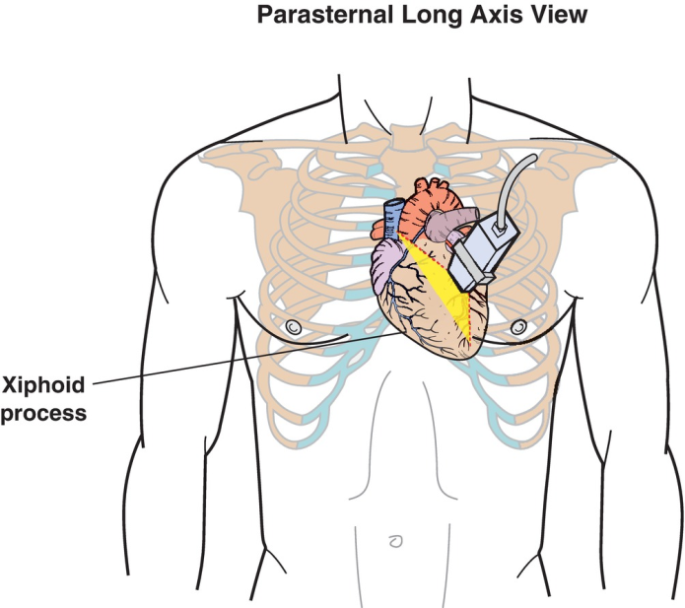
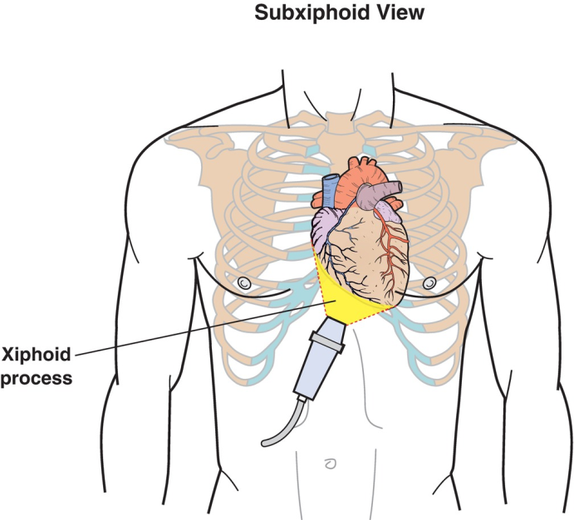
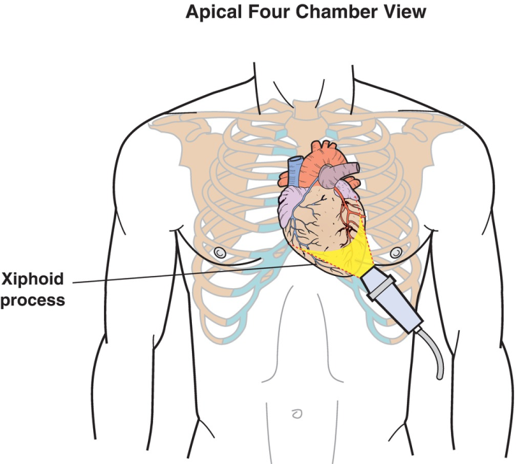
Echocardiography (cont.)

Slide 20
Care and Cleaning of Transducers
Do not drop transducers or roll the machine over the cords.
If you find a crack in the transducer housing, report it to your supervisor.
Transducers should never be autoclaved.
Transducers used topically (and their cords) should be cleaned with manufacturer-recommended disinfectant before and after each examination.
Transducers used for intracavity purposes may be disinfected with a glutaraldehyde-based solution.
Close monitoring and documentation of transducer disinfection are warranted.

Slide 21
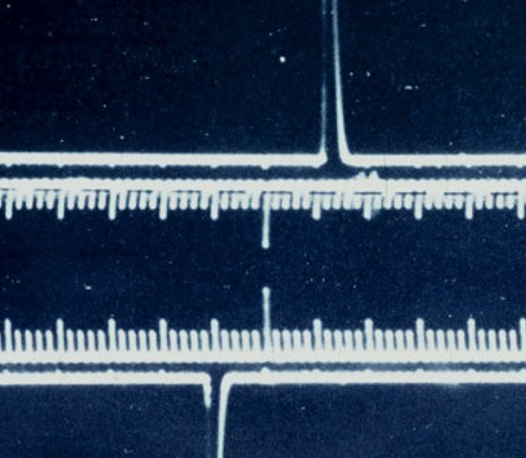
A-Mode and B-Mode
A-mode, or amplitude mode
Early ultrasound systems used an amplitude-modulation type of display. A Mode provided simple displays that were plotted as a series of peaks, the height of which represented the depth of the echoing structure from the transducer.
Brightness mode (B-mode imaging) displays the returning echoes as dots of varying brightness related to the strength of the echo.
Real-time imaging is the ability of the machine to gather information and display it on the screen almost instantaneously.
Real-time B-scan technique is a combination of the two and is used today.

Slide 22
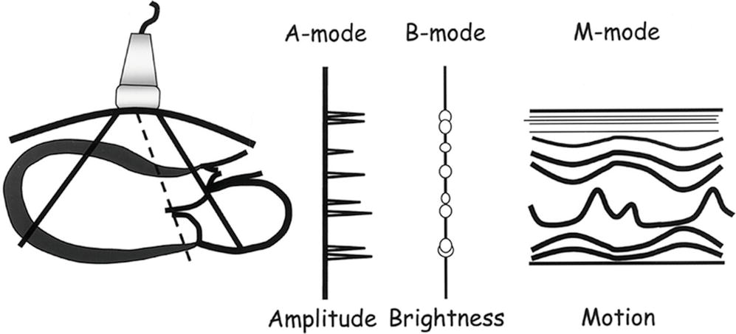
A-Mode and B-Mode (cont.)

Slide 23
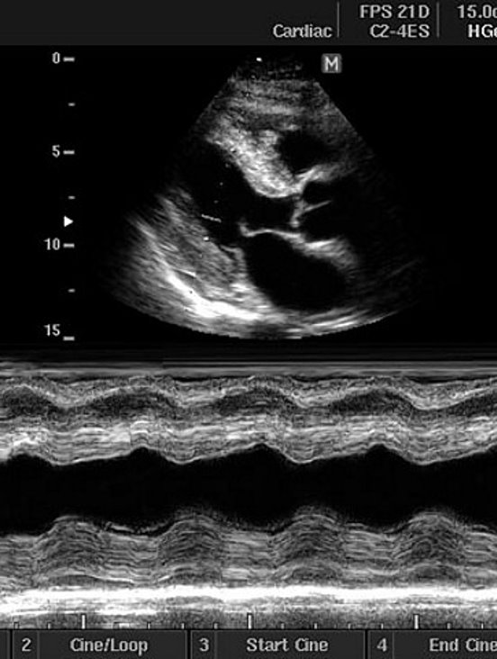
M-Mode and Basic Doppler Overview
M Mode: motion-modulation.
It is a variation of B mode where the display is a single dimension of time which represents the motion of various reflectors.
It is commonly used in echocardiographic studies and to measure fetal heart rate.
Doppler technology: relates to the effect of differing frequencies with motion.
This may be described as continuous-wave Doppler, pulsed-wave Doppler, color Doppler imaging, and power Doppler.
Unlike CW, PW Doppler allows the sonographer to select the depth at which the measurement will be taken.

Slide 24
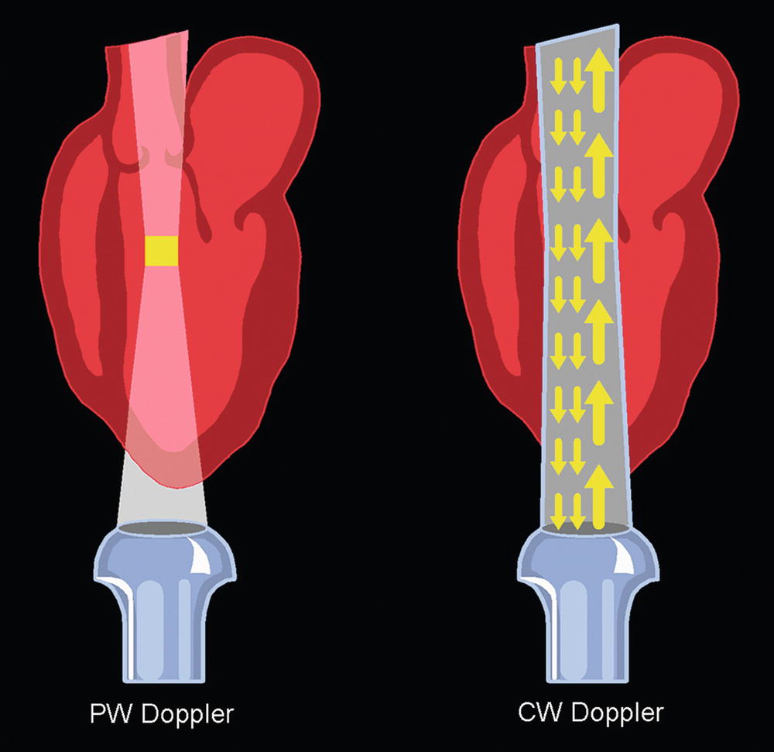
Basic Doppler Overview (cont.)
Fundamental difference between PW Doppler (left) and CW Doppler (right). CW Doppler utilizes only one crystal for sending ultrasound and another crystal for listening. For this reason, CW transducers are always listening for the returning signal. In contrast, PW Doppler intermittently transmits sound. Between transmissions, the transducer pauses briefly to listen for the returning signal. This allows the ultrasound system the ability to select a single area of interest to interrogate.

Slide 25
Essential Universal Knobology
Knobology is the study of knobs or the functionality of controls.
Many of the controls on ultrasound machines are actually touch-screen buttons.
It is your obligation to become familiar with the controls and abilities of the ultrasound machines you are using.

Slide 26
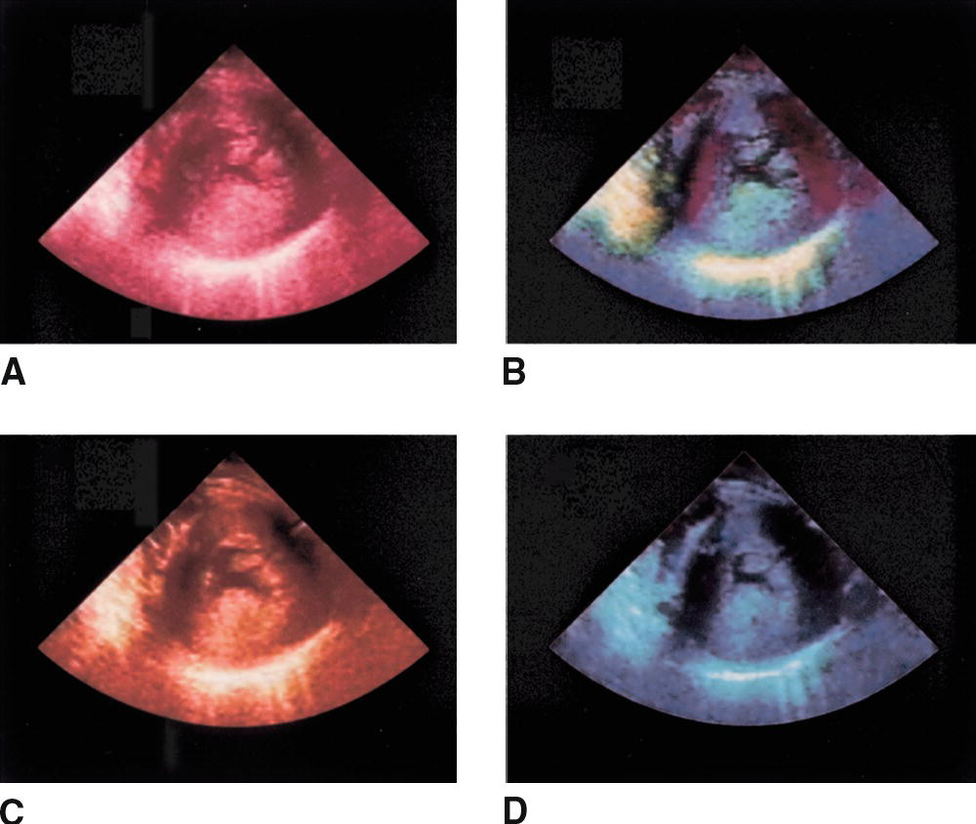
Essential Universal Knobology (cont.)
Functions on the ultrasound machine include the following:
Acoustic power
Annotation keys
B-color
Body markers
Calipers
Cine (cine loop)
Color (Doppler)
Continuous-wave Doppler
Depth
Dual image
Ellipse
Field of view (extended field of view)
Freeze

Slide 27
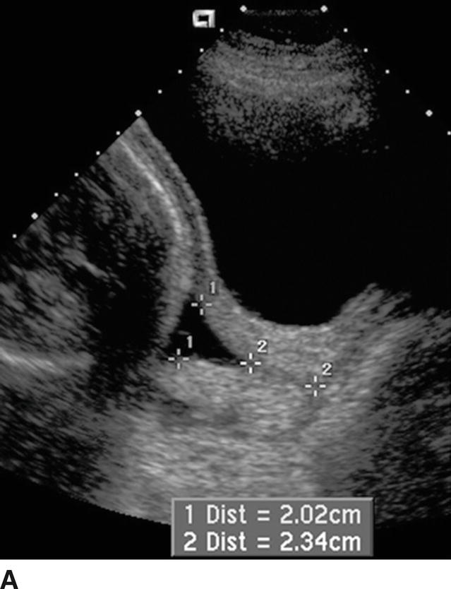
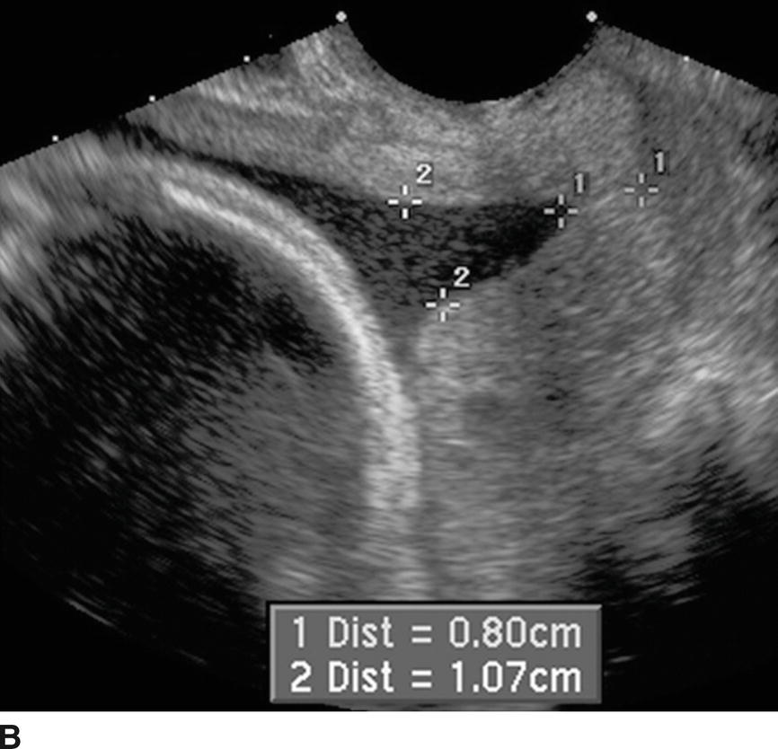
Essential Universal Knobology (cont.)
Electronic calipers are used for taking measurements.

Slide 28
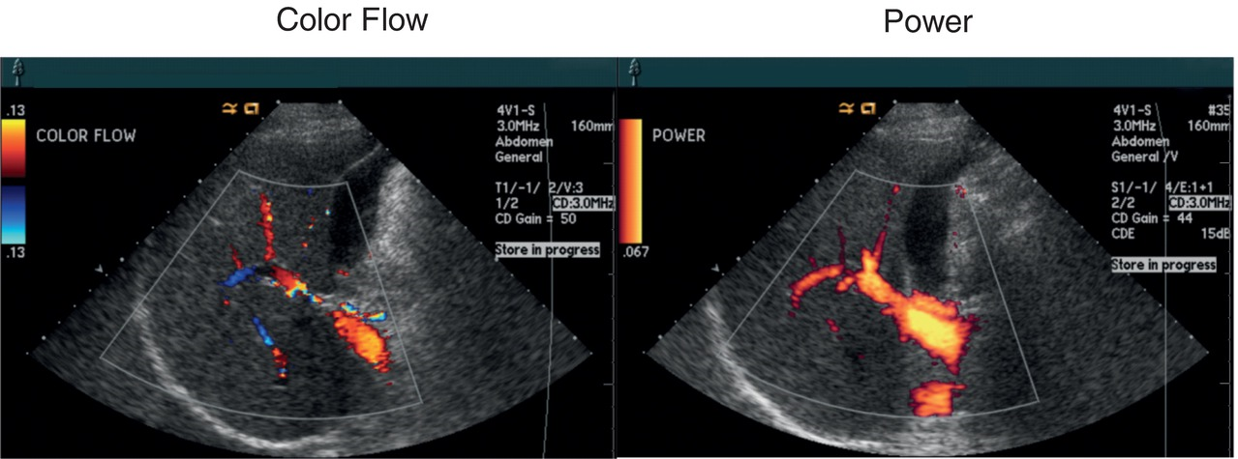
Essential Universal Knobology (cont.)
A comparison of color Doppler (left) and power Doppler (right) images reveals the enhanced sensitivity of the power Doppler compared to standard color Doppler. Flow directionality, however, is not available in the power Doppler image

Slide 29
Essential Universal Knobology (cont.)
Functions on the ultrasound machine include the following (cont.):
HD zoom
Image store/print
MultiHertz
Overall gain
Time gain compensation
Tissue equalization
Trace
Trackball
Transducer select
M-mode
Pulsed-wave Doppler
Transmit zone or focus
Zoom

Slide 30
Buttons Most Commonly Used in Echo
Volume
Patient
Probe
Review
Physio
TGC’s******
Depth******
Freeze
Save******
Measure******
Trackball******
Set
Cursor
Zoom
End exam******
Report******
“B” Overall Gain******
“M” M mode
******Used very frequently

Slide 31
Volume, Patient, Probe & Physio
Volume-turns the spectral Doppler audio up or down.
Patient-brings up identification page where patient information such as name, DOB, patient ID, etc can be added.
Probe-allows sonographer to select cardiac probe when multiple probes are connected to US machine.
Physio-changes the appearance of the ECG display so that a clear P, R, and T wave can be seen without interfering with the image. (bigger, smaller, higher, lower)

Slide 32
Review, End Exam, Report
Review-allows sonographer to look at stored images already saved.
End exam-finalizes echo and sends the exam to the hard drive and reading station.
Report-List all measurements and pertinent values (such as Ejection fraction) for quick review of quantitative data.
M-mode-after cursor button has been selected and placed pressing the M-mode button will bring up the M-mode graph of the structure where the cursor was placed.

Slide 33
Understanding Gain
Gain or amplification changes the brightness of your entire image.
It works by amplifying the sound signal that is received by the machine from the body.
Increasing gain makes the image brighter
Decreasing gain makes the image darker

Slide 34
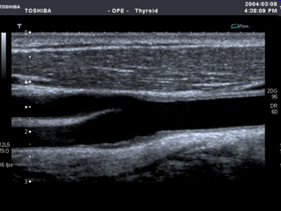
Gain too low
Gain too high
Perfect gain!

Slide 35
Time Gain Compensation (TGC)
TGC controls the brightness of the image at different depths.
TGC evens out the brightness of an image.
Without TGC the bottom of your image would be dark because sound weakens as it travels.

Slide 36
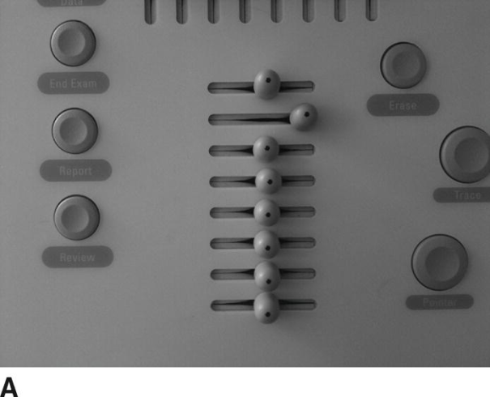
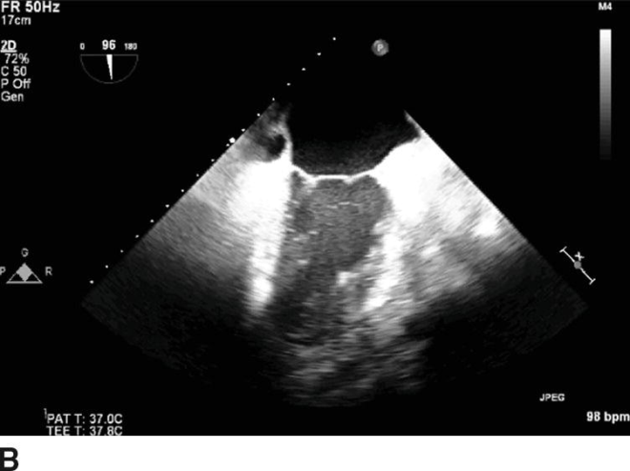
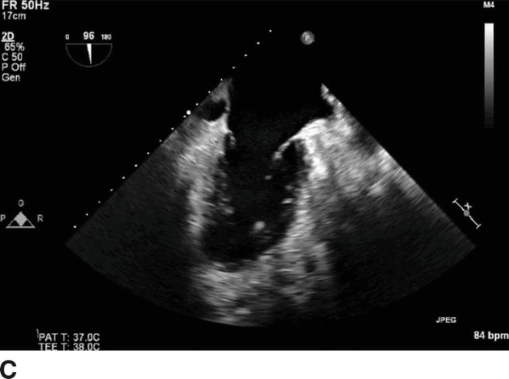
Time Gain Compensation (TGC)
A. The TGC is determined by a series of sliding controls referred to as slide pots. The upper controls affect the near field, or the area closest to the transducer face, while the lower controls affect the far field, or the area farthest away from the transducer. B. High settings of the second control affect part of the middle of the image. C. Improvements to the TGC result in a more uniform brightness and thus better image quality. It is important to note that some machines may have digital TGC controls.

Slide 37
Depth
The depth knob controls the imaging depth of the machine
Shallow depth would be closer to the surface of the skin, deep depths are deeper in the body or farther away from the skin surface

Slide 38
Doppler
There are many different kinds of Doppler. ​
Color Doppler colorizes blood flow within the body so that we can better visualize blood vessels and blood flow. ​
Spectral Doppler measures the velocity and assigns a wave diagram to various vessels and structures.

Slide 39
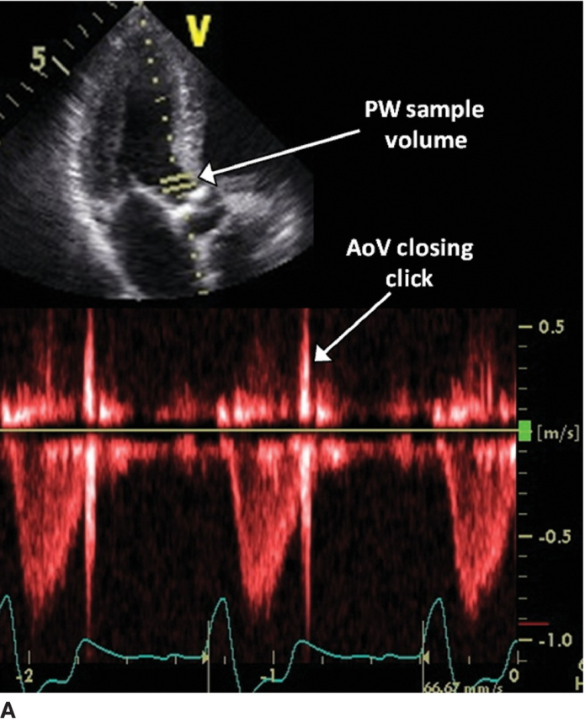
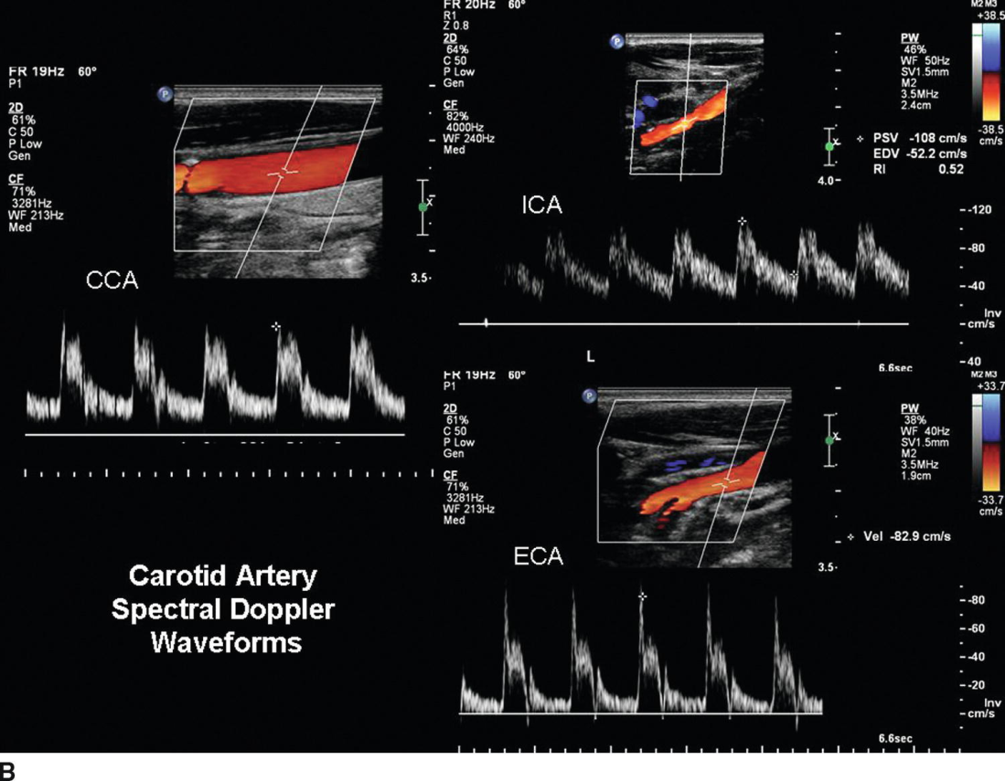
Doppler
A. Correct positioning of the sample volume during pulsed-wave (PW) Doppler acquisition in the left ventricular outflow tract so that only the closing click of the aortic valve (AoV) is seen and there is little spectral broadening. B. Spectral Doppler waveforms of the carotid artery and its tributaries.

Slide 40
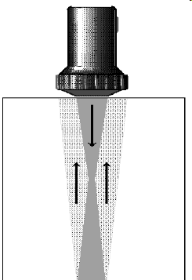
Focus
Ultrasound beams are shaped like an hourglass
The best images are created when the beam is narrowest. This is called the focus
Resolution is the ability to image accurately

Slide 41
Focus
Focus allows us to improve our image in certain areas
It works by making the sound beam narrow which creates a better picture.

Slide 42
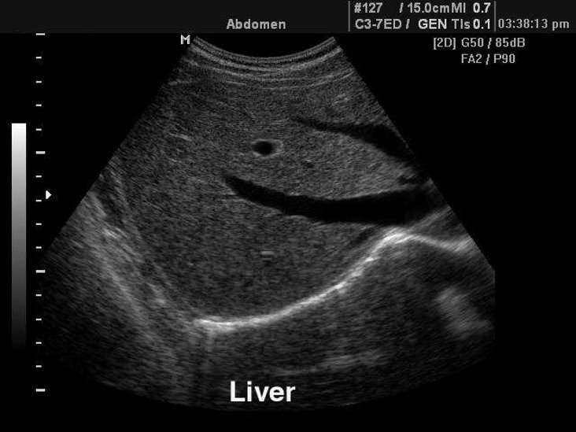
Focus
Focus

Slide 43
Freeze & Cine-loop
Freeze is simply that – it freezes your image
Cine-loop is a feature that allows us to move backwards up to 10 frames (similar to rewind)

Slide 44
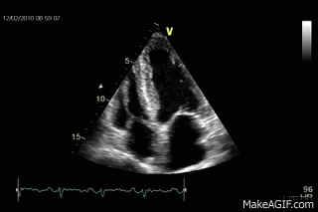
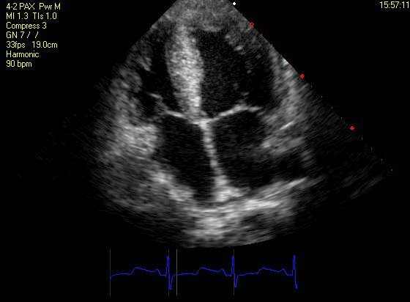
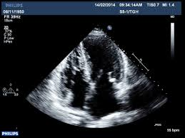
B-Mode Image
Freeze
Cine-loop

Slide 45
Summary
Sonographers have an obligation to understand the various functions of the ultrasound equipment that they are required to operate in the clinical setting.
In fact, in some clinical settings, several ultrasound manufacturers’ equipment may be utilized, and thus specific training may be warranted.
You should strive to become familiar with all ultrasound equipment while you are learning.
The best way to learn more about the ultrasound machines that you use in clinical is to observe and to practice.
If possible, utilize breaks between examinations to learn the various functions of each knob.

